Slide 1

NFL – Analysis Design tab –> design ideas - has some good ones and https://slidesgo.com/search?q=sport or that link and superbowl marketing campaign? I’m okay with anything ( : Notes: if you click on image in jupyter lab and paste (keep sourcing format the image looks good)
Cory Potter
Morgan Tighe
Sami Abu-Douleh

Slide 2
Weather influence score outcome. Home field advantage matter. Are scores rising over time.
Stadiums – includes Indoor and outdoor/retractable
Teams – by NFC vs. AFC and divisional breakdown
Scores
each game score seasons: 1966 – 2019
Temperature

Slide 3
What questions we found interesting and what motivated you to answer them
Does weather effect over under
Does weather effect total points in game
Does weather influence score outcome Does home field advantage matter

Slide 4
Summarize where and how we found the data
Kaggle Open Datasets
www.kaggle.com
Football was starting and we had an interest in looking at sports metrics
When we clicked the search field NFL was a trending search
“NFL scores and betting data” is where we found 3 CSV files

Slide 5
Describe the data exploration and cleanup process (accompanied by Jupyter Notebook)
Read in 3 files
Cut data to 2002 – 2018 Regular Season Data
We wanted to look at recent activity after new divisions were created in 2001
We had to exclude 2019 due to weather information not being available
Converted fields to numeric

Slide 6
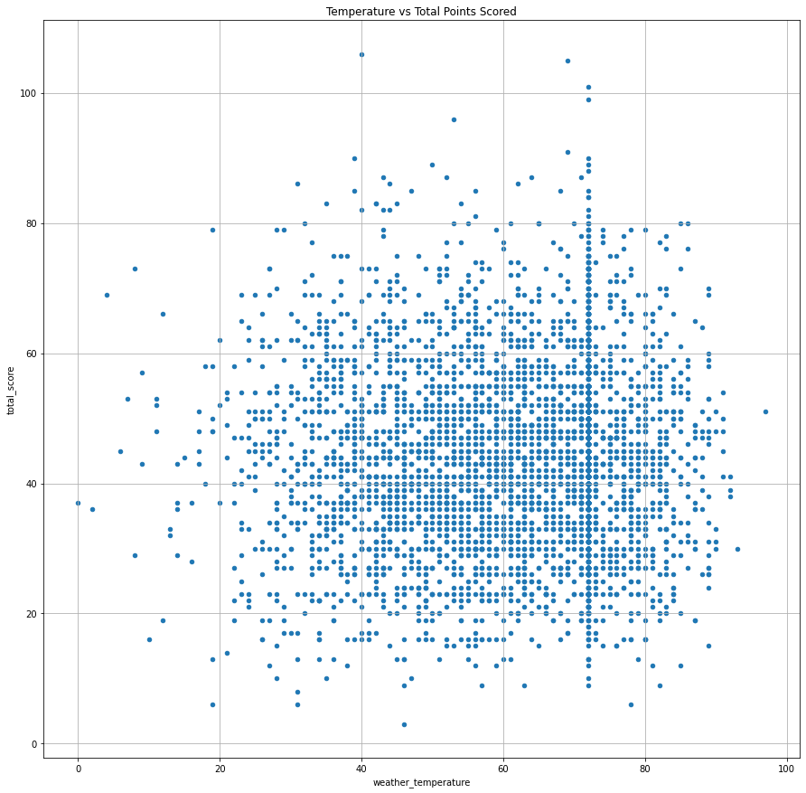
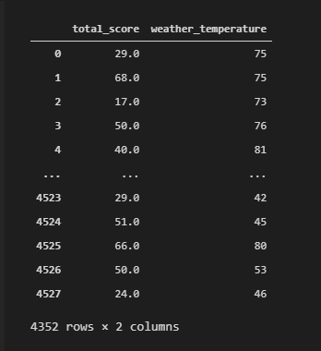
Temperature vs Total Points Scored in game (both teams combined)
~99% of Dome games are at 72 degrees Fahrenheit
Scores can vary based on weather temp but the top 15 highest game scores have occurred above freezing/32 degrees with average temp of 61 degrees. The bottom 15 with points scored had an average of 51 degree temperature

Slide 7
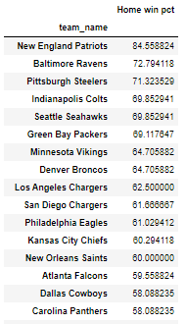
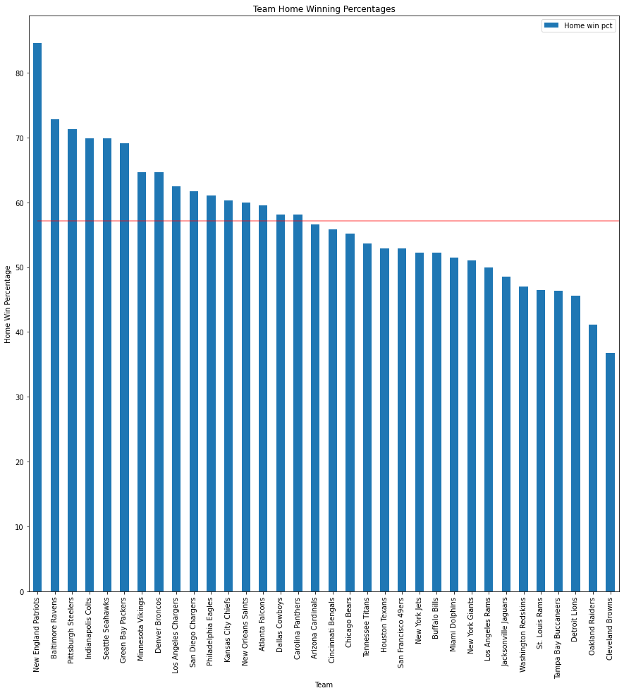
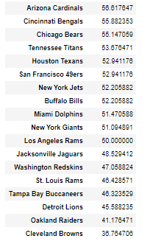
Among all NFL teams - team wins ~57% of the time at home
New England Patriots win 84.6% of their home games which is over 11% higher than the next best team Baltimore Ravens
Baltimore is ranked 10th in winning % but 2nd in home winning %

Slide 8
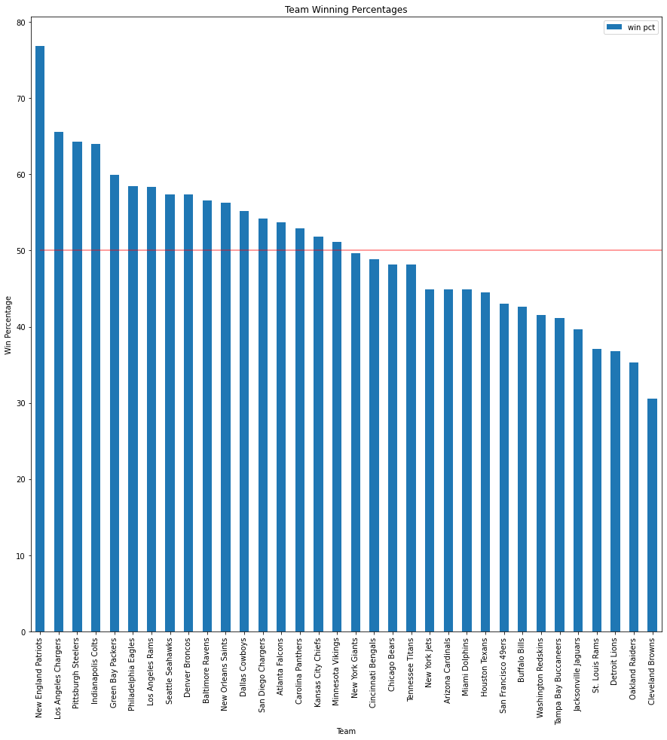
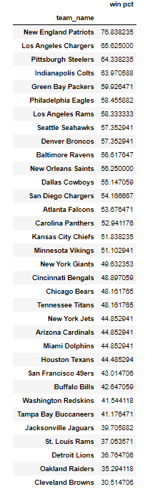
New England tops the list again…
Small sample size for both Los Angeles teams but both teams improved winning % after the move(through end of 2018 season)
2015 last season for Rams in STL
2016 last season for SD

Slide 9
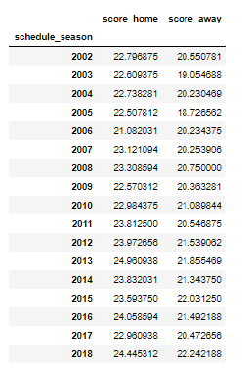
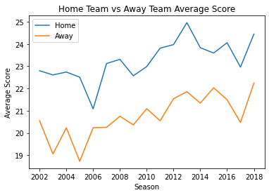
Summarize Conclusions – numberical summary (what data did your analysis yield), as well as visuals/plots
The trend of average score of both home and away teams is trending up.
The point differential was the closest in the 2006 season

Slide 10
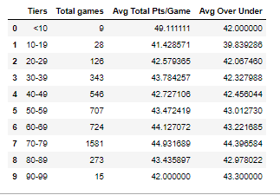
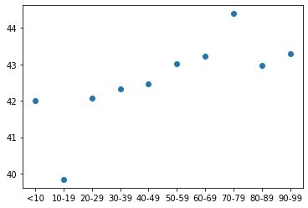
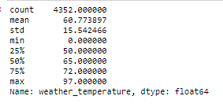
Summarize Conclusions – numberical summary (what data did your analysis yield), as well as visuals/plots
The largest category of weather temperature was between 70-79 (36% of all games)
The highest average over under is 44.4 which does fall within the 70-79 degree weather

Slide 11
Describe Analysis (accompanied by Jupyter Notebook)

Slide 12
Implications of findings. Open-ended discussion about what your findings mean

Slide 13
Thank you

